Slide 1




ENGINEERING
EXPLORATION

Slide 2

What is Engineering?
Engineering is the application of science and mathematics to design, build, and improve machines, structures, and systems.
Engineers identify real-world problems and develop practical, efficient, and innovative solutions.

Slide 3
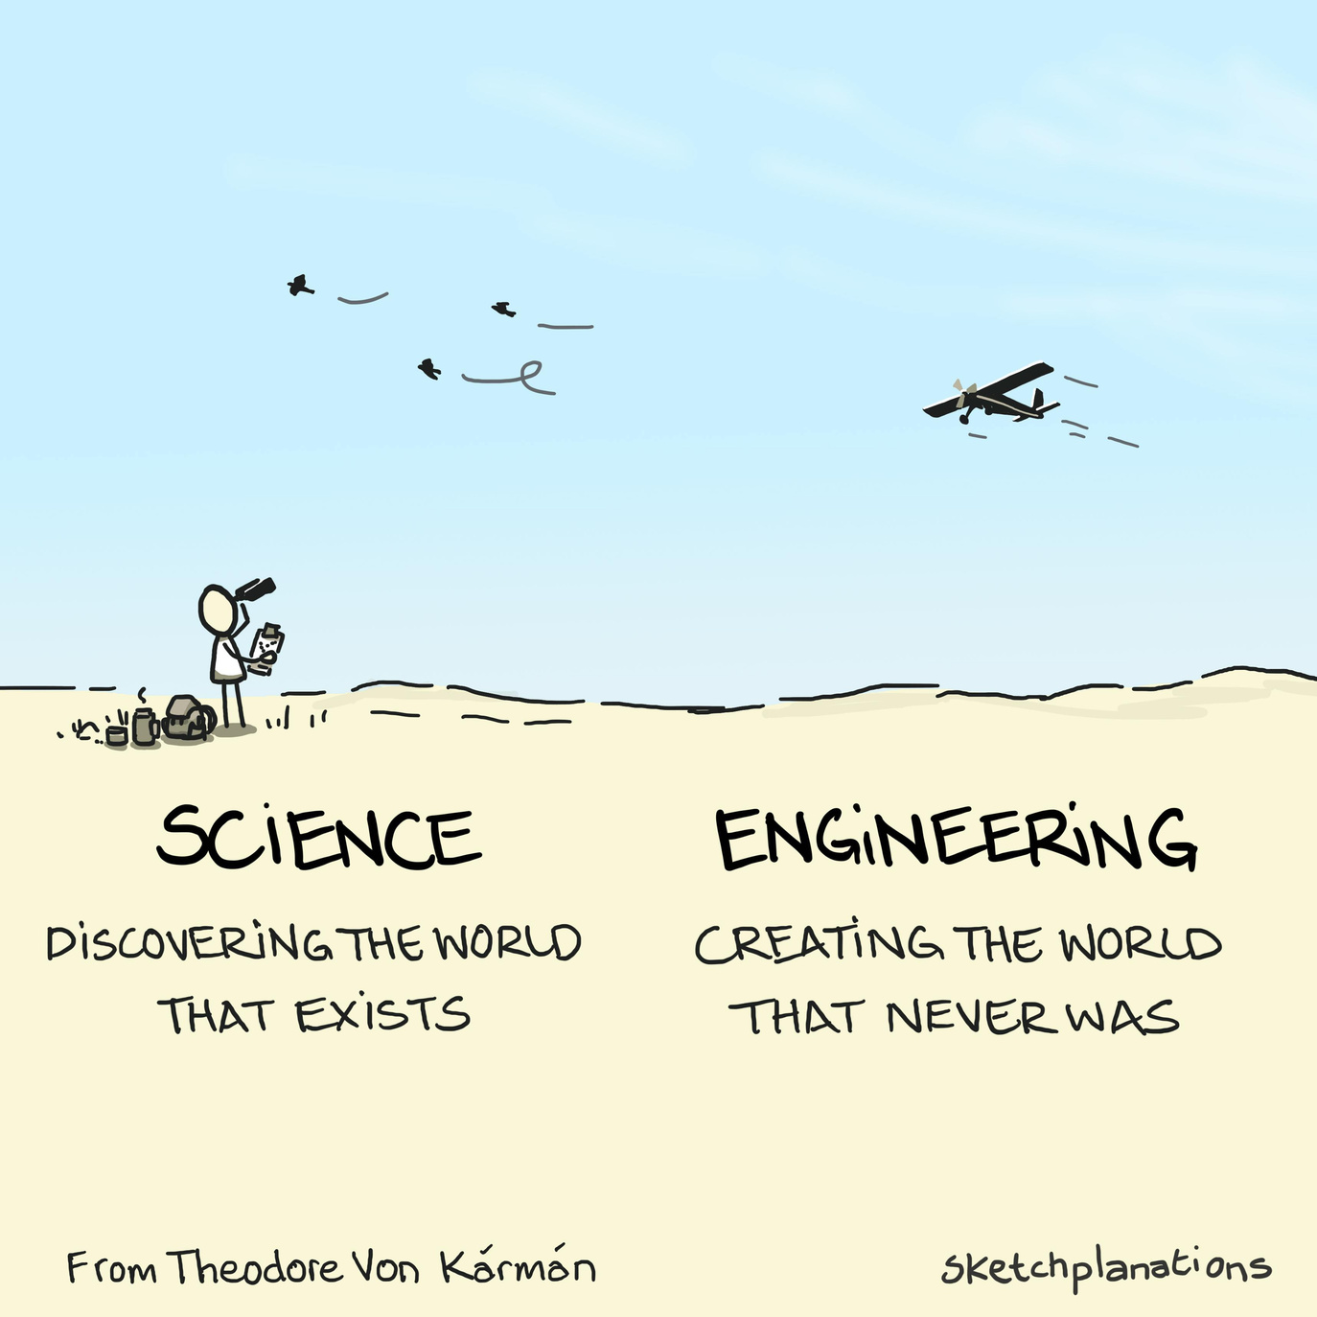
Difference between
Science and Engineering
SCIENCE ENGINEERING
Science studies how nature works. Engineering uses science to solve problems.
It focuses on finding new knowledge. It focuses on making useful products.
Scientists do research and experiments. Engineers design, build, and improve things.
Example: Studying gravity or electricity. Example: Building bridges, machines.

Slide 4
Difference between
Scientist and Engineer
SCIENTIST
A scientist studies and discovers new knowledge.
Scientists perform research and experiments.
Their goal is to understand how things work.
Example: A physicist studying gravity.
ENGINEER
An engineer uses scientific knowledge to solve problems.
Engineers design, build, and improve products and systems.
Their goal is to create useful solutions for people.
Example: A civil engineer designing a bridge.
01
02

Slide 5


Needs and Wants
Needs of CSE :
1. Solve real-world problems using computers and software.
2. Store and protect data securely and efficiently.
3. Develop reliable software and computer systems for various applications
.
Wants of CSE :
1. Create smart technologies like Artificial Intelligence (AI) and Robotics.
2. Develop faster and user-friendly applications to improve daily life.
3. Innovate new technologies to make work easier and more efficient
.

Slide 6


Disciplines of Engineering
1. Civil Engineering – Designs and constructs buildings, roads, bridges, and dams.
2. Mechanical Engineering – Designs, manufactures, and maintains machines and mechanical systems.
3. Electrical Engineering – Deals with electricity, power generation, electrical circuits, and electronic devices.
4. Computer Science and Engineering (CSE) – Develops computer software, hardware, networks, and information systems.
5. Electronics and Communication Engineering (ECE) – Focuses on electronic circuits, communication systems, and signal processing.
6. Chemical Engineering – Uses chemistry to produce chemicals, medicines, fuels etc.
,

Slide 7
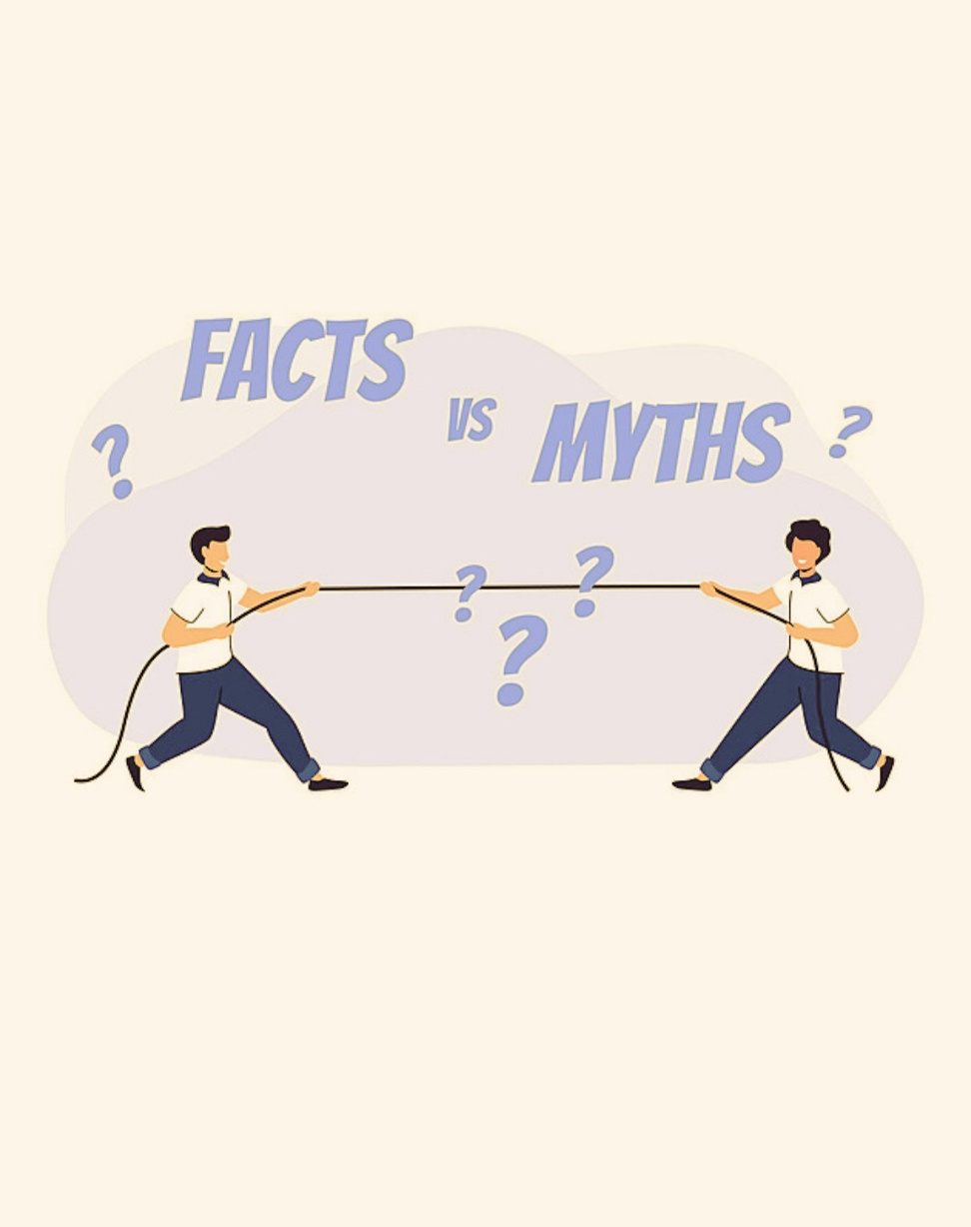
Misconceptions of CSE
Misconception: CSE is only about coding.
Fact: It includes coding, networking, AI, cybersecurity, and databases.
Misconception: CSE students only work on computers.
Fact: They create software, apps, websites, and solve real-life problems.
Misconception: Only very intelligent students can study CSE.
Fact: Anyone can learn CSE with interest, practice, and hard work.
Misconception: CSE graduates can only become software engineers.
Fact: They can work in many fields like AI, data science, cybersecurity, web development, and cloud computing.

Slide 8

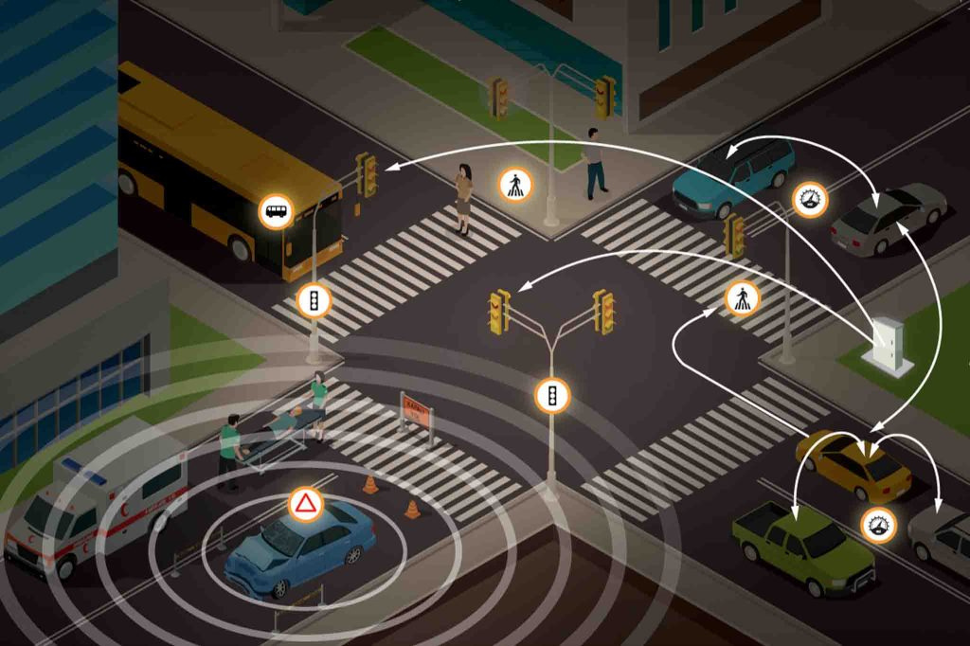
Case Study
CASE STUDY: Traffic Signal Management System
PROBLEM
In a busy city, traffic congestion causes long waiting times, fuel wastage, and accidents.
ENGINEERING SOLUTION
Computer Science and Electronics engineers developed a Smart Traffic Signal System that uses cameras and sensors to detect traffic density and automatically adjust signal timings.
RESULT
Reduced traffic congestion.
Saved fuel and travel time.
Improved road safety.
Faster movement of emergency vehicles.
CONCLUSION
This case study shows how engineering uses technology to solve real-life problems and improve people's daily lives.

Slide 9
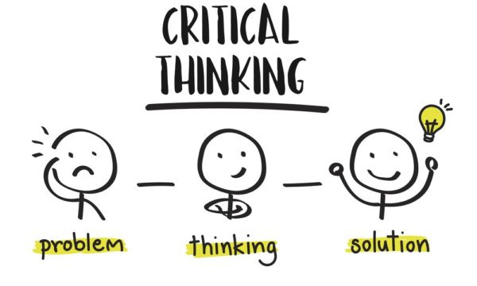
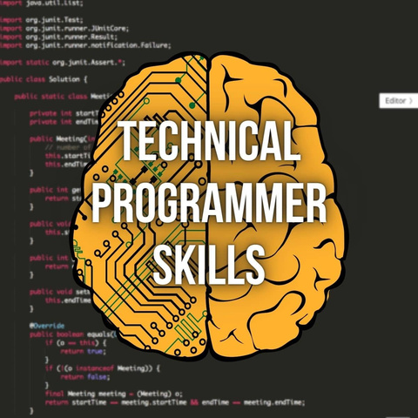

Skills Required
Skills Required for CSE in the 21st Century:
1. Problem-Solving Skills
Ability to identify problems and find effective solutions.
2. Programming Skills
Knowledge of programming languages such as C, Java, or Python.
3. Communication Skills
Ability to explain ideas clearly and work well with others.
4. Critical Thinking
Ability to analyze situations and make good decisions.
5. Creativity and Innovation
Ability to develop new ideas and improve existing technologies.
6. Teamwork
Ability to collaborate with others to complete projects successfully.
7. Adaptability
Willingness to learn new technologies and keep up with changes.

Slide 10
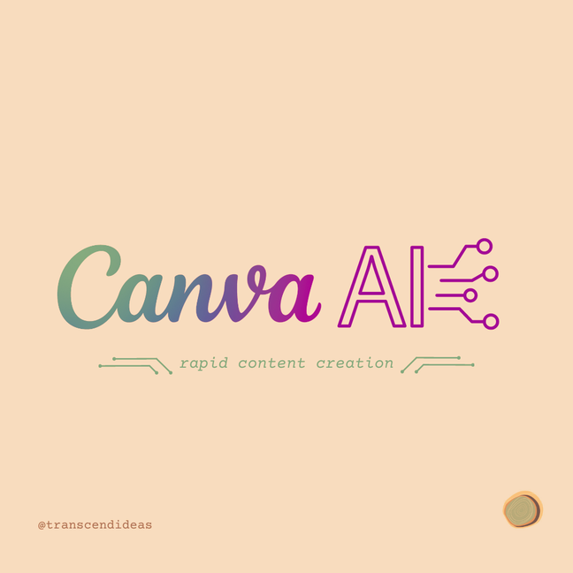
Canva Ai
Canva Ai
Summary:
Easy to create: Canva provides ready-made templates and an easy drag-and-drop editor to design presentations quickly.
AI-powered: Canva AI can automatically generate slides, images, and content from a simple prompt.
Professional output: It helps create attractive, high-quality presentations that can be shared or downloaded as PPT or PDF.

Slide 11
Thank You

